Slide 1
Word Vectors - GloVe
Natural Language Processing
(based on revision of Chris Manning Lectures)

Slide 2
Announcement
TA announcements (if any)...

Slide 3
Suggested Readings
https://web.stanford.edu/~jurafsky/slp3/6.pdf (vector semantics and embeddings)
Distributed Representations of Words and Phrases and their Compositionality (negative sampling paper)
GloVe: Global Vectors for Word Representation (original GloVe paper)
Co-occurrence matrix (hacks to co-occurrence matrix)
Improving Distributional Similarity with Lessons Learned from Word Embeddings
Evaluation methods for unsupervised word embeddings
A Latent Variable Model Approach to PMI-based Word Embeddings
Linear Algebraic Structure of Word Senses, with Applications to Polysemy
On the Dimensionality of Word Embedding

Slide 4
Negative Sampling

Slide 5
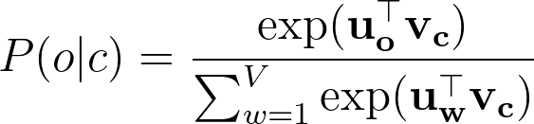
Negative sampling [Mikolov et al., NeuroIPS 2013]
The normalization term is computationally expensive.
Huge cost!
Idea: Instead of using all vocabularies, we can just pick some “negative” samples. We just need to make the difference between positive and negative samples to be big.
Distributed Representations of Words and Phrases and their Compositionality, Mikolov et al., 2013, https://proceedings.neurips.cc/paper/2013/file/9aa42b31882ec039965f3c4923ce901b-Paper.pdf

Slide 6
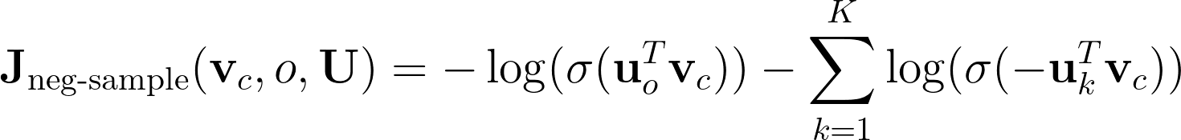
Negative sampling
We draw k random negative samples
We maximize the probability of real outside word appears, and minimize the probability that random words appear around the center word
Note: Since we are not normalizing, we use sigmoid instead to turn the dot product to probabilities
Negative sampling is a widely used technique in the deep learning field, not only NLP

Slide 7
Limitations of Word2vec
Only look at local words
Does not utilize global co-occurrence statistics
Possible solution: use co-occurrence counts (GloVe)
Does not work well with out-of-vocabulary
Possible solution: use character based or sub-words embedding (e.g., FastText)
Doubtful whether contextual information was fully captured
Possible solution
passed these trained embeddings through some LSTM, and get the resulting encodings as embeddings (ELMo)
Provide some different prediction tasks such as fill in the blanks or fill in next sentence, so that the model can capture better context (BERT)

Slide 8
Co-occurrence matrix

Slide 9
Co-occurrence matrix
2 options: windows vs. full document
Window: Similar to word2vec, use window around each word -> capture some syntactic and semantic information
Document: similar to Latent Semantic Analysis
For word embeddings, we use window-based

Slide 10
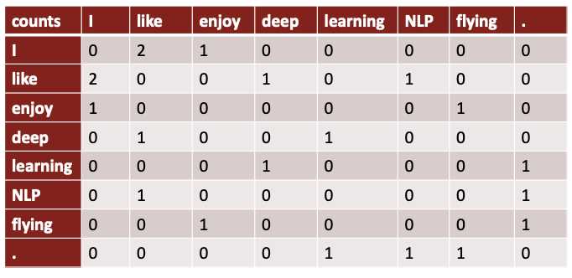
Co-occurrence matrix: Example
Example: Window length 1 (more common: 5-10)
Example corpus:
“I like deep learning”
“I like NLP”
“I enjoy flying”

Slide 11
Co-occurrence matrix: Problem
Simple count co-occurrence vectors
Very high dimensional: require a lot of storage (though sparse)
Low dimensional vectors
Idea: store only the “most” important information in a fixed, small number of dimensions, i.e., a dense vector
Usually 25-1000 dimensions, similar to word2vec
How to reduce the dimensionality?

Slide 12

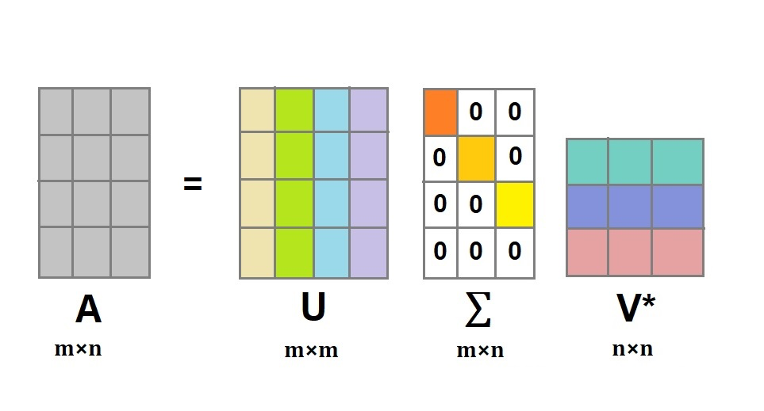
Co-occurrence matrix: SVD [Rhode et al. CogSci 2005]
Use SVD! (Basically PCA).
Singular Value Decomposition of co-occurrence matrix X
The reduced matrix is where k is the dimension you want
Image source: askpython.com
An Improved Model of Semantic Similarity Based on Lexical Co-Occurrence, Rhode et al. 2005, https://arxiv.org/pdf/1301.3781.pdf

Slide 13
Co-occurrence matrix: Hacks to X [Rhode et al. CogSci 2005]
Rhode et al. 2005 found that running an SVD on raw counts doesn’t work well
Scaling the counts in the cells can help a lot
Problem: frequent words (the, he, has) have too much impact
Fixes:
Log the frequencies
min(X, t), with t = 100 for example
Ignore these words
Ramped windows that count closer words more than further away words
Use Pearson correlations instead of counts, then set negative values to 0
An Improved Model of Semantic Similarity Based on Lexical Co-Occurrence, Rhode et al. 2005, https://arxiv.org/pdf/1301.3781.pdf

Slide 14
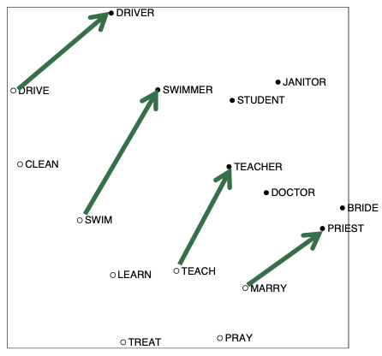
Co-occurrence matrix: Rhode results
Interesting semantic patterns emerge in the scaled vectors

Slide 15
GloVe

Slide 16
Towards GloVe: Count based vs. Prediction-based
Count-Based Good:
Fast-training
Efficient usage of statistics
Bad:
Scale badly to frequent words
Use mainly to capture word similarity
Prediction-Based
Good:
Transfer to better classification performances
Capture complex patterns beyond word similarity
Bad
Inefficient usage of statistics
Idea: Can we combine the best of both worlds?

Slide 17
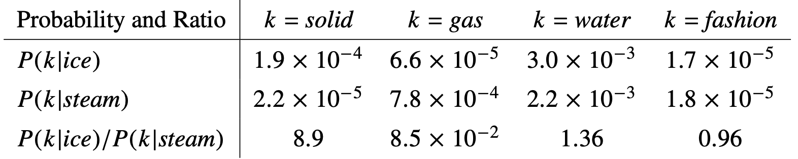
GloVe [Pennington et al., EMNLP 2014]
Pennington et al. (2014) are aware that there are problems with raw counts
They found that ratios of co-occurrence probabilities can encode meaning
GloVe: Global Vectors for Word Representation, Pennington et al. 2014, https://aclanthology.org/D14-1162.pdf

Slide 18
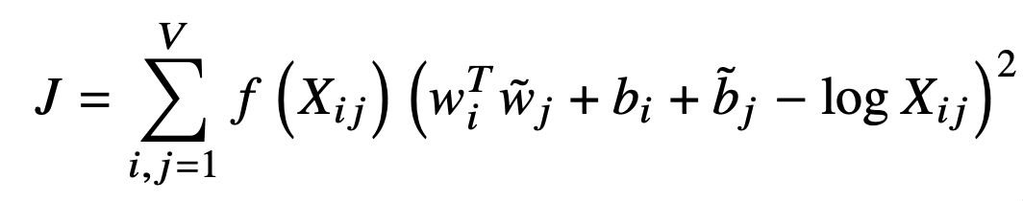
GloVe
Statistics are scalar; turning it into a loss function is not a simple task. Through some bits of math, the authors find that the statistics can be expressed into the following (Chaky walk through the paper)
f is just some capping function for frequent items or rare occurrences
b_{i} and b_{j} are just some bias terms
Fast training, scalable to large corpus
Good performance, even with small corpus and small vectors
Read https://towardsdatascience.com/light-on-math-ml-intuitive-guide-to-understanding-glove-embeddings-b13b4f19c010 further if you are interested in easier version of the math derivation

Slide 19
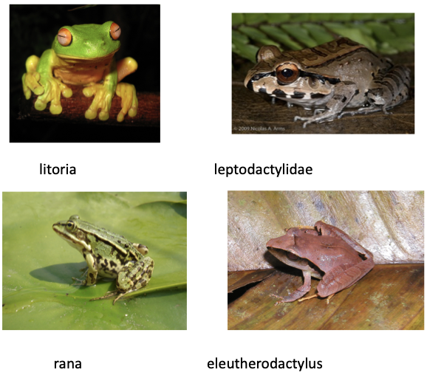
GloVe results
Nearests words to frog

Slide 20
Word Vectors Evaluation

Slide 21
Word vectors evaluation
Intrinsic
Evaluation on a specific/intermediate subtask (e.g., analogies)
Fast to compute
Not clear whether it will improve real task
Extrinsic
Evaluate on real task (e.g., question answering)
Can take long time

Slide 22
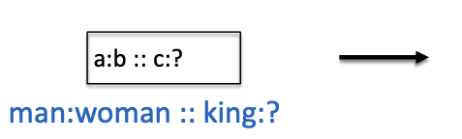
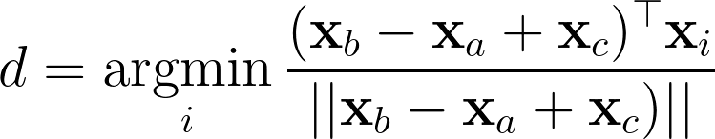
Word vectors evaluation
Intrinsic
Evaluate word vectors by how well they capture intuitive semantic (meaning) and syntactic (grammar) analogy questions.
Analogy task consists of questions like, “a is to b as c is to ?”
The semantic questions are typically analogies about people or places, like “Athens is to Greece as Berlin is to ?”.
The syntactic questions are typically analogies about verb tenses or forms of adjectives, for example “dance is to dancing as fly is to ?”.
To correctly answer the question, the model should uniquely identify the missing term, with only an exact correspondence counted as a correct match.
The question is answered by finding the word d whose representation x_{d} is closest to x_{b} − x_{a} + x_{c} according to this:

Slide 23
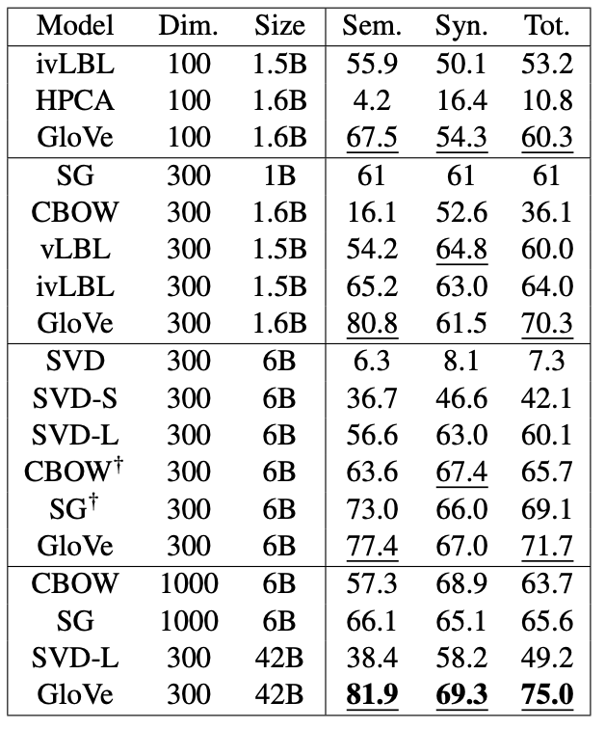
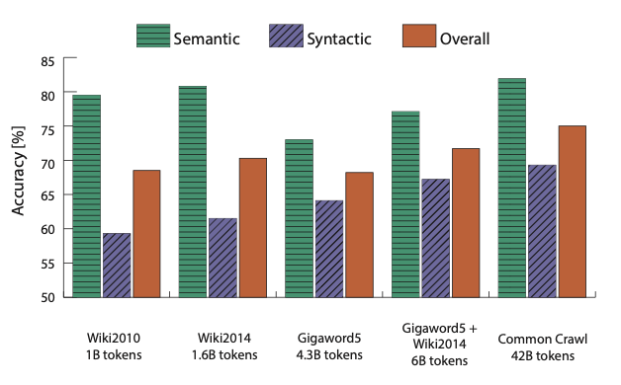
GloVe evaluation

Slide 24
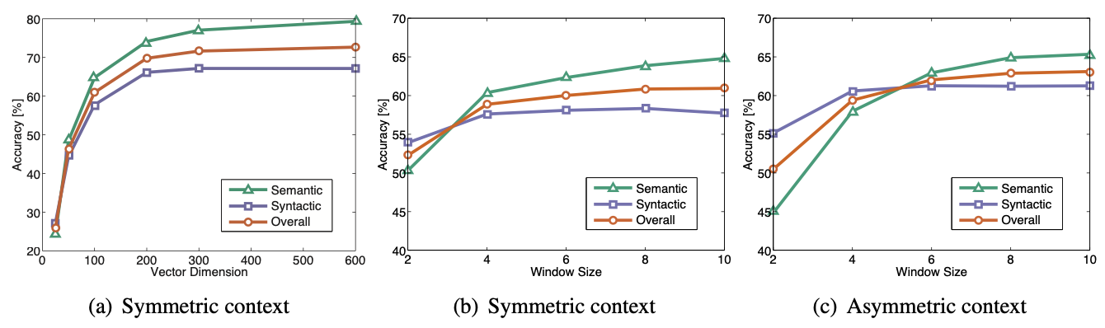
GloVe evaluation

Slide 25
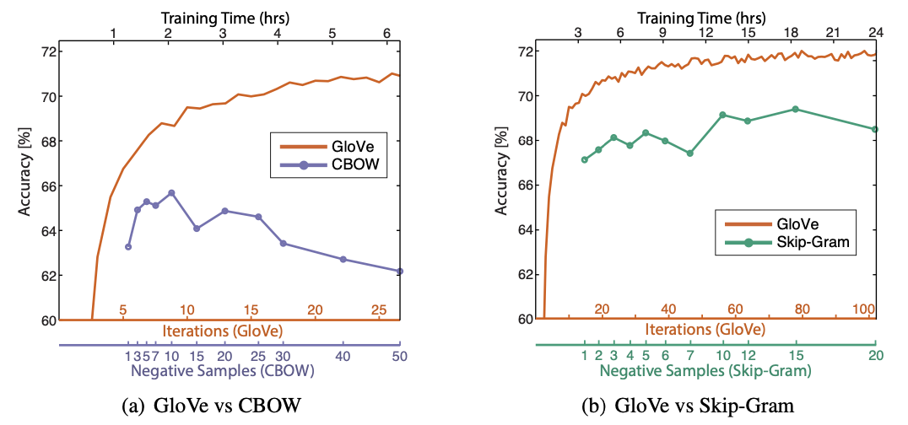
GloVe evaluation

Slide 26
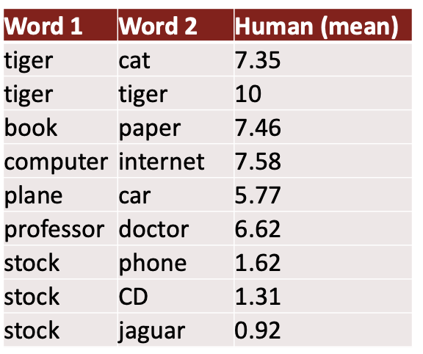
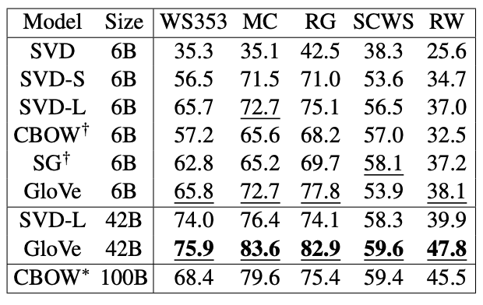
Another intrinsic word evaluation
Correlation with human judgements
Example dataset: WordSim353: http://www.cs.technion.ac.il/~gabr/resources/data/wordsim353/

Slide 27
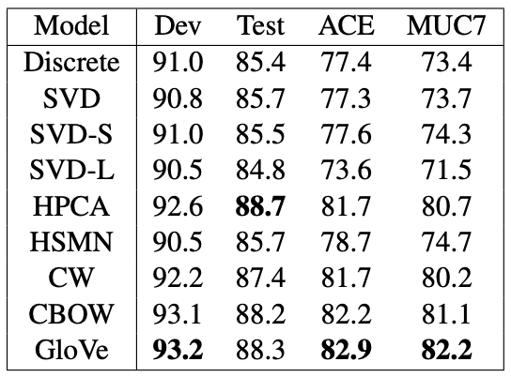
Extrinsic word evaluation
Directly see whether these word vectors improve accuracy in any NLP tasks. For example, here is the task called named entity recognition: identifying person, organization, or location.
Note: CoNLL-2003 English benchmark dataset for NER is a collection of documents from Reuters newswire articles, annotated with four entity types: person, location, organization, and miscellaneous.

Slide 28
Summary
Negative sampling is much better than the naive softmax approach. (It is not only used in NLP, e.g., FaceNet). There remains three big limitations of word2vec:
Local windows (use co-occurrence statistics in GloVe)
Out-of-vocabulary (FastText using character-based embedding)
Not sure about its contextual meanings (ELMo)
Using window-based co-occurrence statistics can help encode meanings but can suffer from high dimensionality; addressed by SVD but not sure whether anything important is lost
GloVe combines best of count-based vectors and prediction-based vectors
Two types of evaluation: intrinsic and extrinsic.
We haven’t yet discussed about FastText (character-based embedding) and ELMo (context). Coming later! We will probably cover RNNs first, since you need to understand those first.

